Slide 1


Ron Williams
Website Revamp And Digital Umbrella Creation
Created By:

Slide 2

Contents
Strategy
New Content
App Integrations
Wireframes
Mobile-Optimized Wireframes
Future Plans

Slide 3


Slide 4
Strategy
Rephrased messaging
Clearly outlined goals and tasks
Setting a timeline
Contiguous feedback loop
Focus on customer journey
Bring everything under the RW umbrella

Slide 5
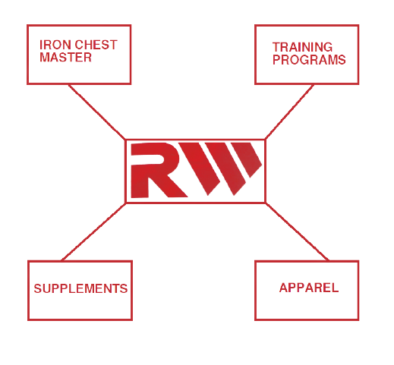

Slide 6
New Content
Photographs of Ron Williams - Working up a sweat - Pumping iron - Flexin’
Fast-paced quick-cut videos of RW work outs
Archival video footage of RW flexing at competitions
High-energy graphic work for backgrounds that inspires and motivates people
Training content

Slide 7
App Integrations
App Integrations

Slide 8
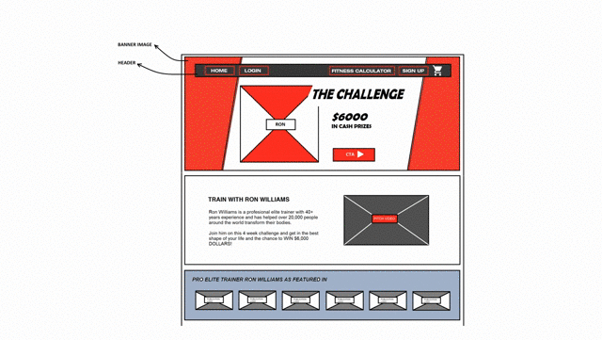
Wireframes

Slide 9
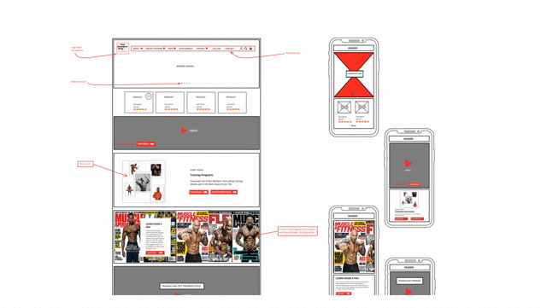
Mobile-Optimized Wireframes

Slide 10
Future Plans
Apparel:
- T-shirts, jerseys, tank-tops, vests, shorts, hats, shoes - Face-masks, wristbands
Inventory - Belts & bags - Shaker bottle
RW Training Mobile App

